Slide 1
A Comparative Study of Programming Languages in Rosetta Code

Slide 2
Time allocation
Overview
Research Method
Programming paradigms overview
Comparison & Results
Validity & Discussion

Slide 3
Overview

Slide 4
Overview
What is the best programming language?
What is the best programming language for feature/project X ?
What are the advantages of a language over another?

Slide 5
Overview
What might affect my selection of language ?
My languages knowledge
Project/company decisions
Moods and trends
Existence of libraries/tools
Open source community/support
Empirical evidence

Slide 6
Empirical Evidence
Conciseness
Maintainability
Performance
Safety
Fit the running environment

Slide 7
Research Method

Slide 8
Purpose
To compare between programming languages.
RQ1 : Conciseness of code.
RQ2 : the Size of Executables.
RQ3 : Running-time performance
RQ4 : Memory usage.
RQ5 : Safety/ failure-proneness

Slide 9
Research Method – Past research
Controlled experiments
Groups of programmers (students)
Small programming tasks
Short life-span
Pros:
Minor variants of the same task (Internal val.)
Cons:
Limited in scope, size, time

Slide 10
Research Method – Past research
Public repositories (GitHub)
“Mature” code
Large projects
Large time-span
Pros:
Closer to the real world (External val.)
Cons:
Programs differ too much

Slide 11
Research Method
Rosetta Code – a code repository
Online, open-source
Purposes
Tasks, Languages, Solutions

Slide 12
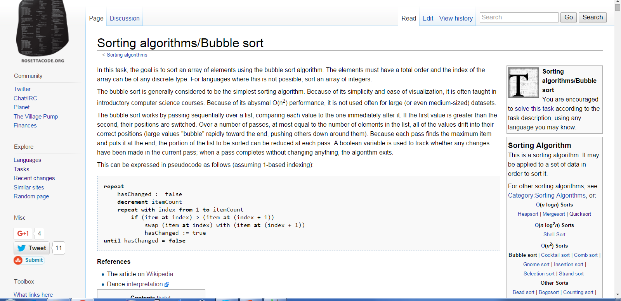
Rosetta code: Task

Slide 13
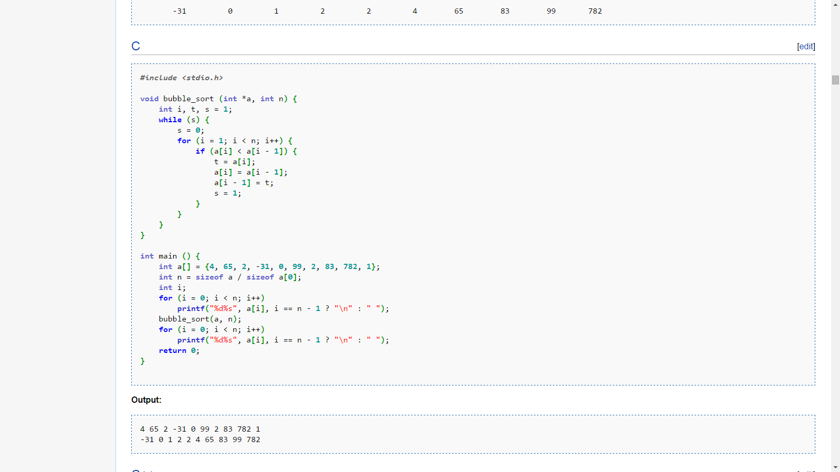
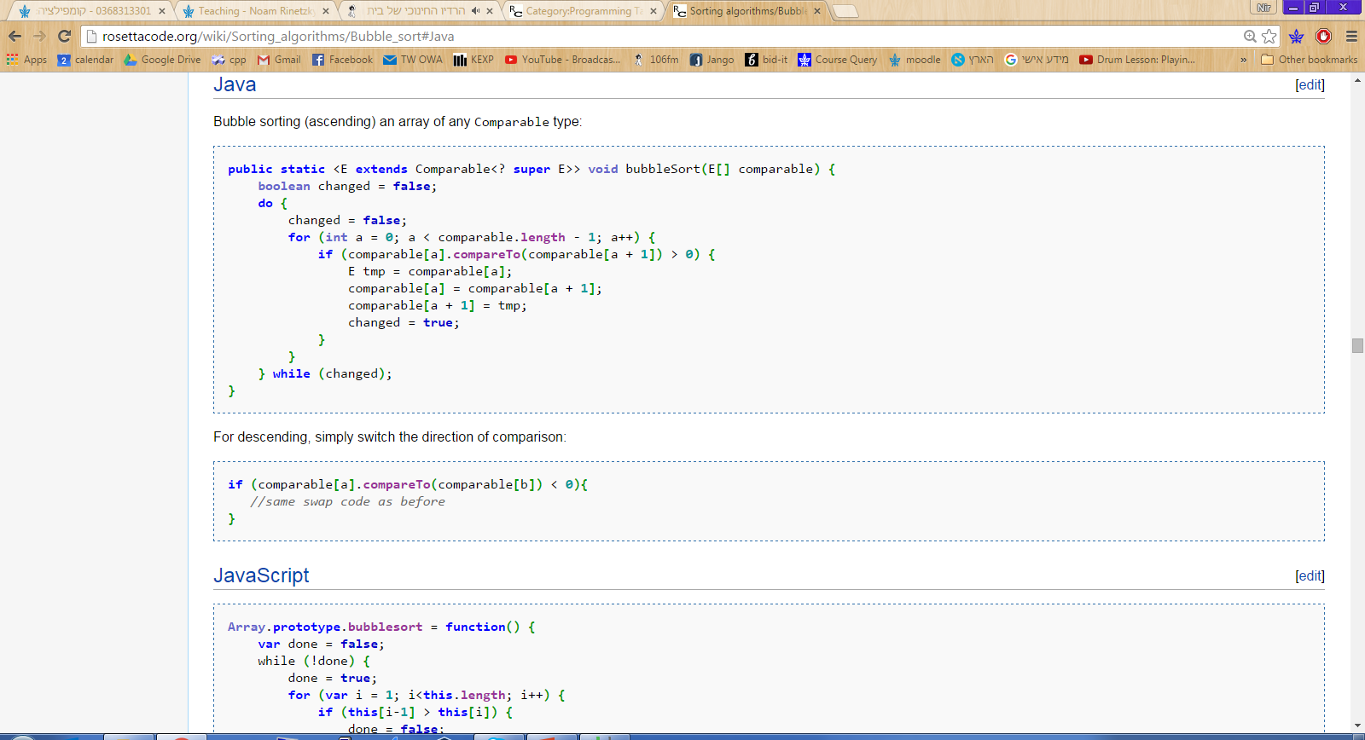
Rosetta code: 2 Solutions for task

Slide 14
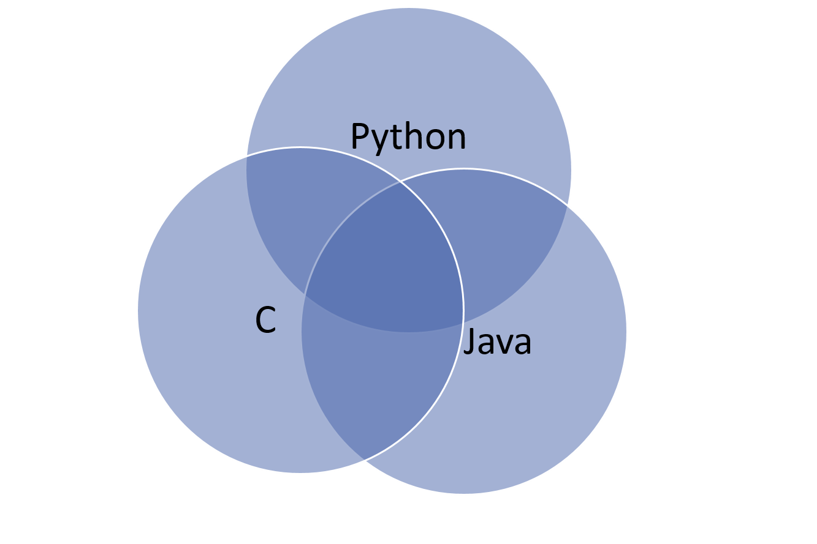
Rosetta code
Tasks, Languages, Solutions
745 tasks, 379 languages

Slide 15
Rosetta code
Task examples
Algorithmic: Bubble sort, Mat-mult, Towers of Hanoi
I/O: GUI application, HTTP request, File I/O
Text: Parsing (XML), Strings
Data structures: List traversal, Trees etc.

Slide 16
Research Method – Task selection
Subset of 436 tasks.
Comparable, Clearly-defined.
Minor variants of a unique problem.
96% compile and run.

Slide 17
Research Method – Language selection
Select from 379 languages (!):
Prefer popular languages (TIOBE rating).
Solve 1/3 from Rosetta’s tasks.
Better statistic analysis.
Mitigate “Hyped” languages.

Slide 18
Research Method
8 languages that were compared.
Popular but didn’t make it: C++, Perl, Javascript, PHP
Less popular but here: Go, Haskell
Procedural | Object- Oriented | Functional | Scripting
C | Java | Haskell | Python
Go | C# | F# | Ruby

Slide 19
Time allocation
Overview
Research Method
Programming paradigms overview
Comparison & Results
Validity & Discussion

Slide 20
Programming Paradigms

Slide 21
Definition
Programming Paradigm = Fundamental style of a language.¹
i.e. Java follows object-oriented paradigm.
Some languages are multi-paradigm.

Slide 22
Languages by paradigms
Languages in study:
Procedural | Object- Oriented | Functional | Scripting
C | Java | Haskell | Python
Go | C# | F# | Ruby

Slide 23
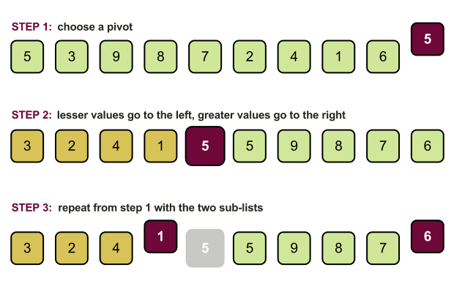
Programming Paradigms
Let’s demonstrate the PP’s by a known algorithm:
Quicksort:

Slide 24

Procedural Paradigm
Procedural programming is based upon the concept of procedure calls.
Each procedure = a set of computational steps to carry out.
Sequential.
Examples: C, Go, C++

Slide 25
Procedural Paradigm
Programming with side effects.
Top-down approach:
one “main” procedure
has 5-6 sub routines, each built once again on 5-6 subroutines.
And so on
Other approaches (recursive).

Slide 26
Procedural Paradigm
int main () { int a[] = {4, 65, 2, -31, 0, 99, 2, 83, 782, 1}; int n = sizeof a / sizeof a[0]; int i; for (i = 0; i < n; i++) printf("%d%s", a[i], i == n - 1 ? "\n" : " "); quick_sort(a, n); for (i = 0; i < n; i++) printf("%d%s", a[i], i == n - 1 ? "\n" : " "); return 0; }

Slide 27
Procedural Paradigm
void quick_sort (int *a, int n) { int i, j, p, t; if (n < 2) return; p = a[n / 2]; for (i = 0, j = n - 1;; i++, j--) { while (a[i] < p) i++; while (p < a[j]) j--; if (i >= j) break; t = a[i]; a[i] = a[j]; a[j] = t; } quick_sort(a, i); quick_sort(a + i, n - i); }

Slide 28
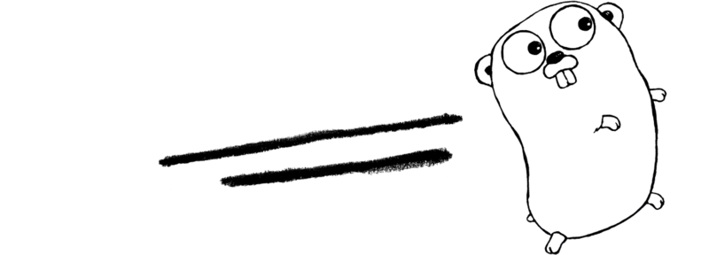
Procedural Paradigm - Go
Go: developed by Google , 2007
Involved founders of C
Statically-typed
Features: Garbage collection, type safety, interfaces
Avoided: NO inheritance, overloading, genericity, or pointer arithmetic

Slide 29
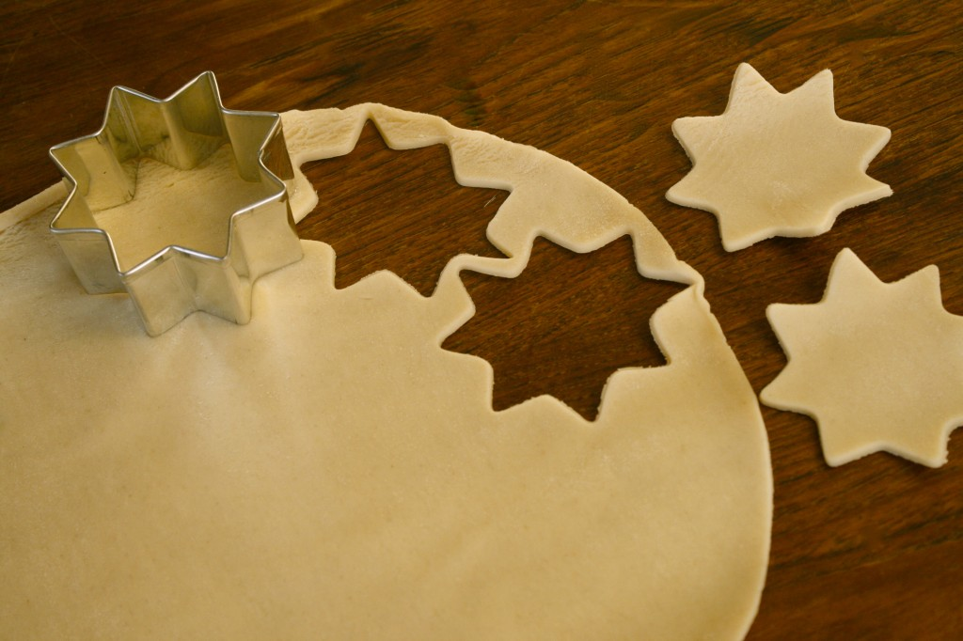
Object oriented paradigm
Based on concept of “Objects”.
Data = “fields”
Code = “methods”
Objects are instances of class (prototype).
Objects access their own data/code.
Interaction with other objects.

Slide 30
Object oriented paradigm
Encapsulation
“Resource Acquisition Is Initialization (RAII)”
Inheritance
Polymorphism
Example languages: Java, C#, C++, Python

Slide 31
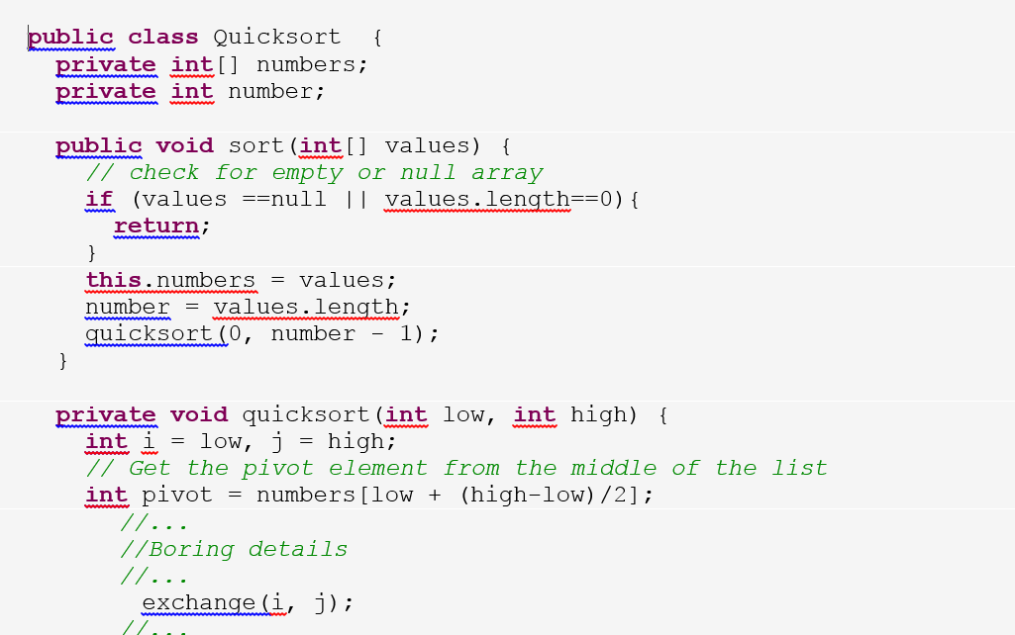
Object oriented paradigm

Slide 32
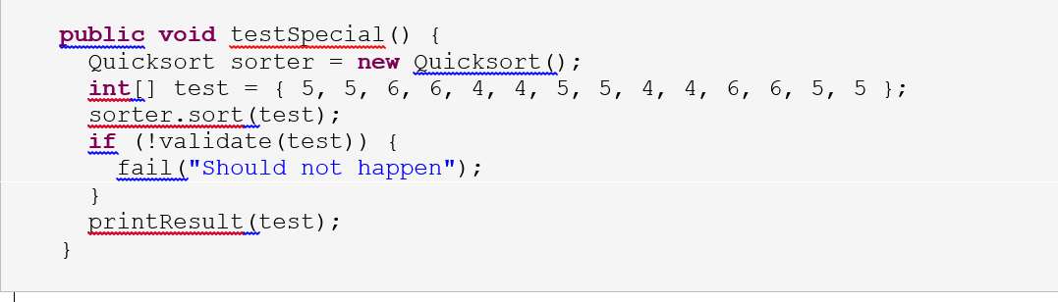
Object oriented paradigm

Slide 33
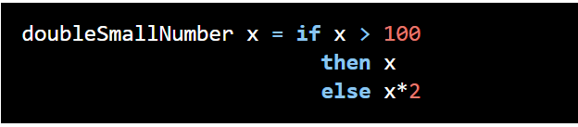
Functional Paradigm
Derived from the word function.
Everything is a function, everything is evaluated.
No side effects !
Example languages: LISP/Scheme, Haskell, F#, ML, Python ...

Slide 34

Haskell
A purely-functional programming language.
Strong static typing
Compiled to native code
Some features: Lazy evaluation

Slide 35
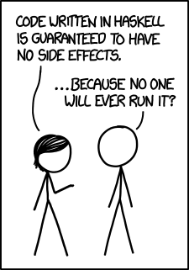
Haskell

Slide 36
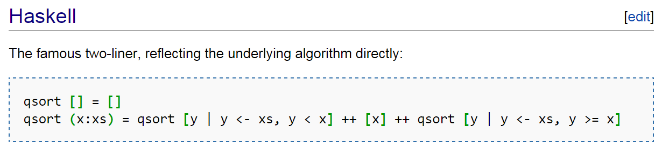
Functional Paradigm

Slide 37
Scripting languages
Interpreted languages.
Python
Ruby
More examples: PHP, Javascript, linux shell

Slide 38
Time allocation
Overview
Research Method
Programming paradigms overview
Comparison & Results
Validity & Discussion

Slide 39
Comparison & Results

Slide 40
Conciseness
RQ1 : Which programming language make for more concise code ?

Slide 41
Conciseness
RQ1 : Which programming language make for more concise code ?
Non-comment, non-blank lines of code
Not required to run correctly, or even compile
Shortest solution for each task in a language

Slide 42
Why it is important?
Bug density is constant across programming languages.
(Meaning – shorter means less bugs.)¹
Readability
Ability for code to be maintained, fixed, enhanced, tested etc.

Slide 43
Example – File I/O
Read file into buffer (in chunks), output to another file.

Slide 44
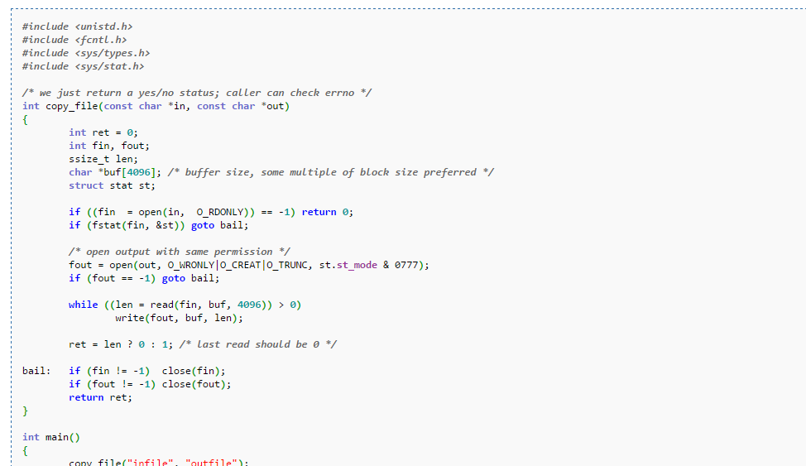
C

Slide 45
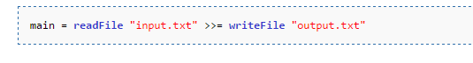
Haskell

Slide 46
What might improve conciseness?
Simplified, expressive syntax
Objects, abstractions
Less checks on variable’s state
Use of external libraries
String interfaces
Collection interfaces

Slide 47

Any guess ?
Conciseness
Procedural | OO | Functional | Scripting
C | Java | Haskell | Python
Go | C# | F# | Ruby

Slide 48
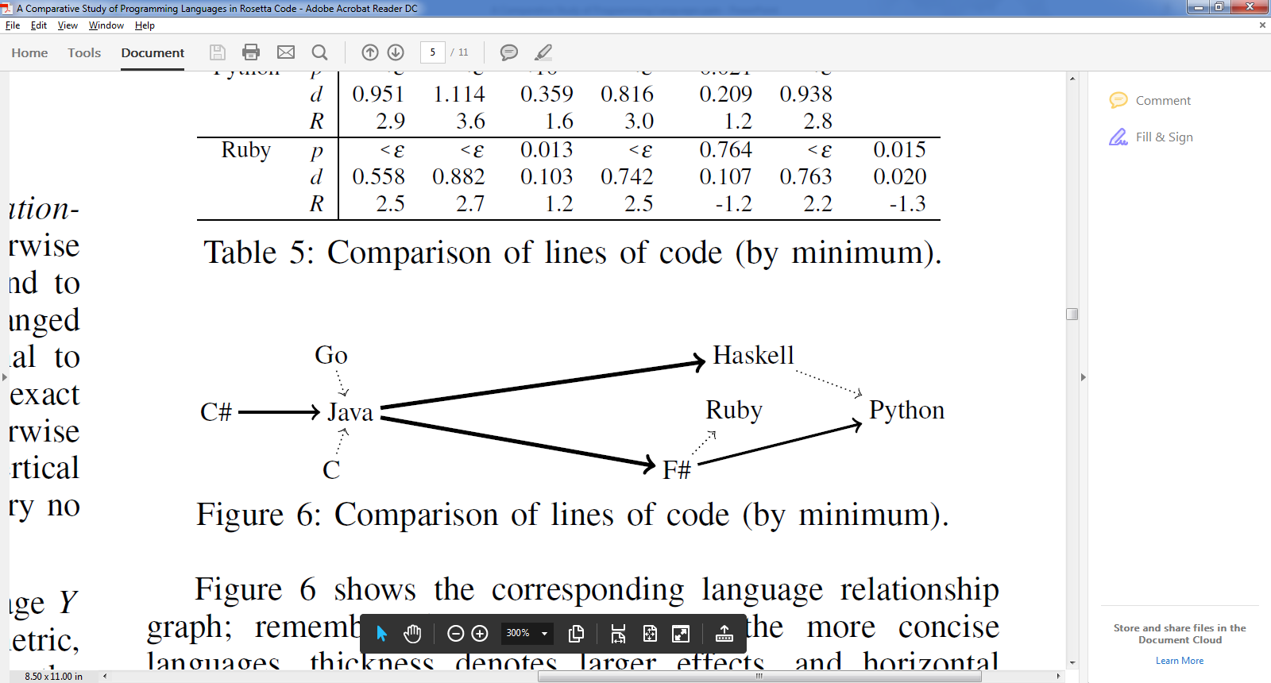
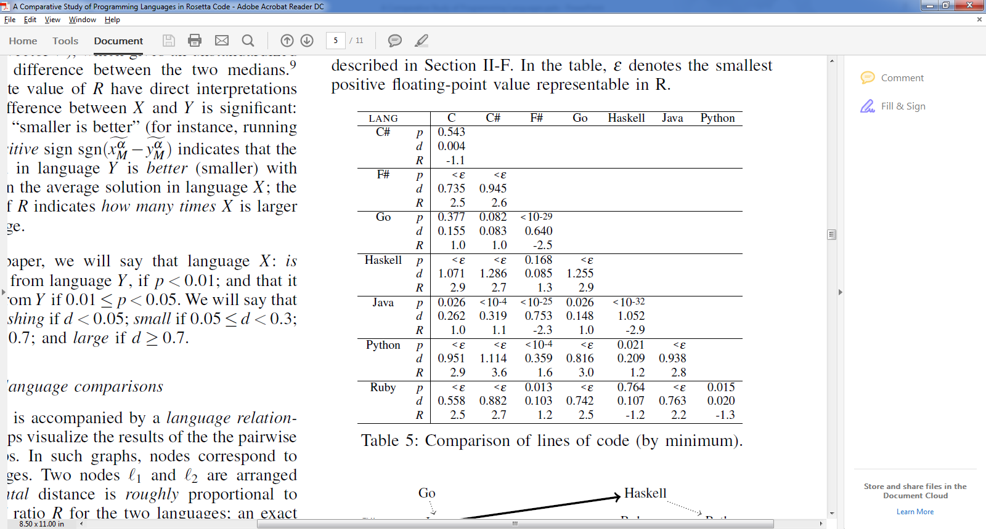
Results – RQ1 (Conciseness / Lines of code)

Slide 49
Conciseness (Lines of code)
Languages divided into two groups:
Group 1: functional and scripting – more concise
Group 2: OO and procedural – longer code
Major differences. i.e. Java 2.2-2.9 longer than Group 1.
Within the groups – no major difference.
Winner (by small amount): Python
Question: Is shorter program easier to understand ?

Slide 50
Results – RQ1 (Conciseness / Lines of code)

Slide 51
Size Of Executable
RQ2 : Which programming language compile into smaller executables ?
Only those compiled successfully.
Ruby language – excluded, has no executable (interpreted).

Slide 52
Why is it important?
Executable consumes HD, network resources.
Executable is loaded into memory.
May turn irrelevant: HD sizes and speed are increasing (SSD).
Embedded systems.

Slide 53
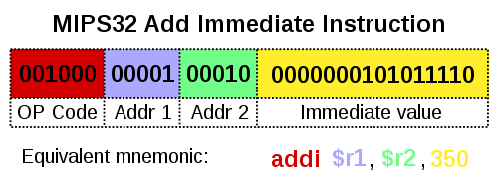
Native code vs. Byte Code
Native code:
Code compiled for particular processor.
Programs compiled into native code:
C, C++, Go, Haskell

Slide 54
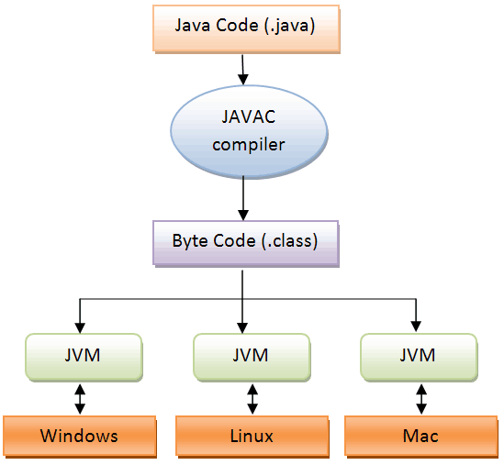
Byte-code
Definition
In real time:
Interpreted (JVM).
Compiled (JIT).
Highly portable.
Example languages: Java, Python, C#, F#

Slide 55
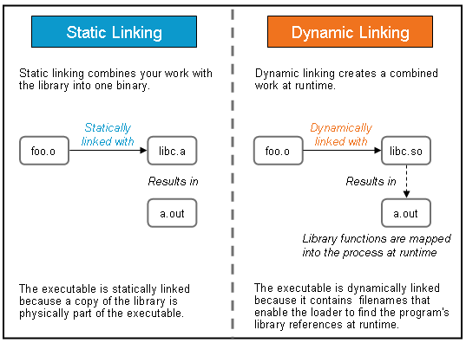
Static vs. Dynamic linkage
Static Linking = Executable contains copies of module .
Dynamic Linking = Executable contains references to module (resolved at runtime).

Slide 56
Any guess ?
Size of executable
 | Language | Byte Code | Dynamic Linking
Procedural | C |  | dynamic
 | Go |  | static
OO | Java | V | -
 | C# | V | -
Functional | Haskell |  | static
 | F# | V | -
Scripting | Python | V | -

Slide 57
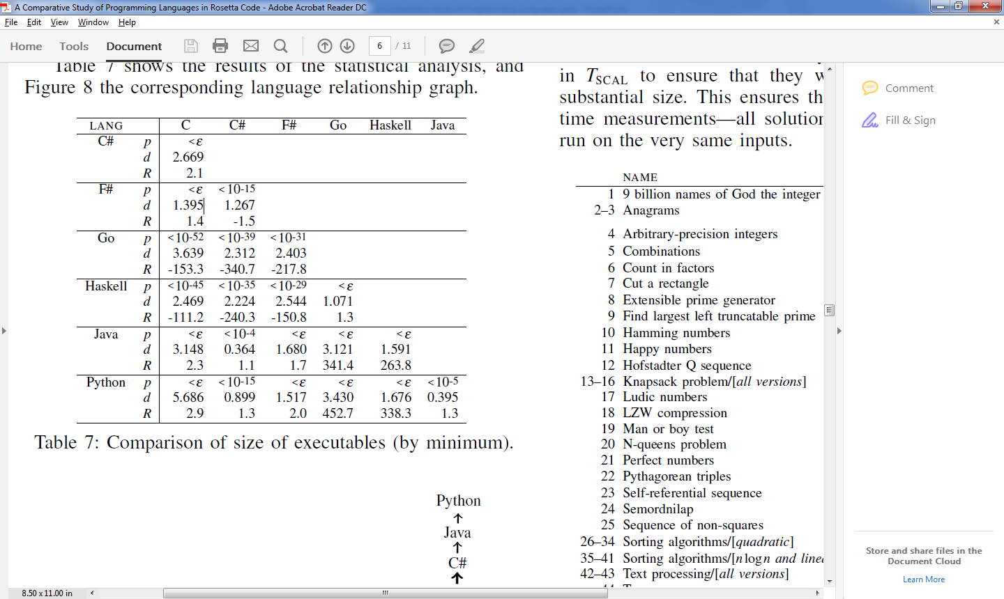
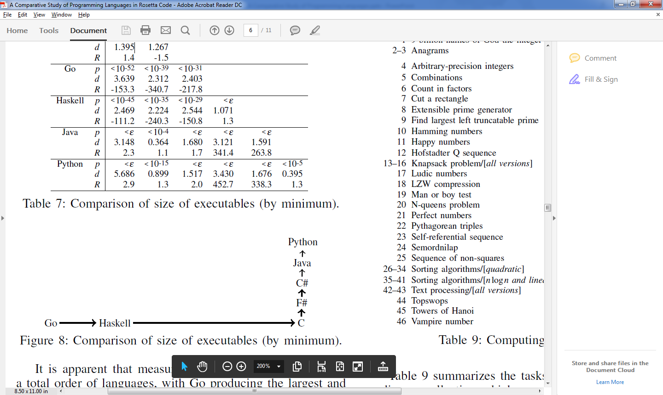
Results – RQ2 (Size of executable)

Slide 58
Size of Executable
Winner (by small amount): Python
Losers: Go, Haskell
Ratio: Big, Java program 263 times smaller than Haskell !

Slide 59
Running Time
RQ3 : Which programming languages have better running-time performance ?
Measure running time.
Small set of “Scalability tasks” (definition)
Exclude errors and timeouts (over 3 mins.)

Slide 60
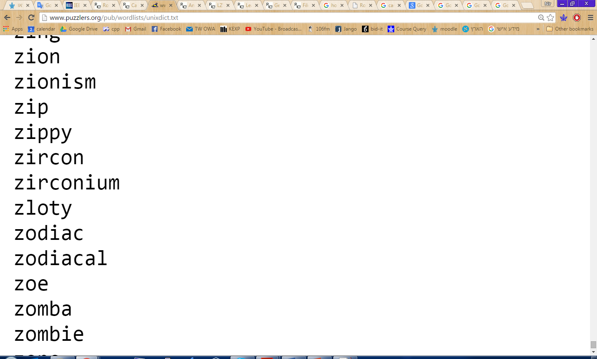
Running Time
Example: Anagrams
Anagram = two words that have the same letters in different order. i.e. veil, levi
Task: on the dictionary in unixdict.txt, find the longest sets of anagrams (sets that contain the most words).

Slide 61
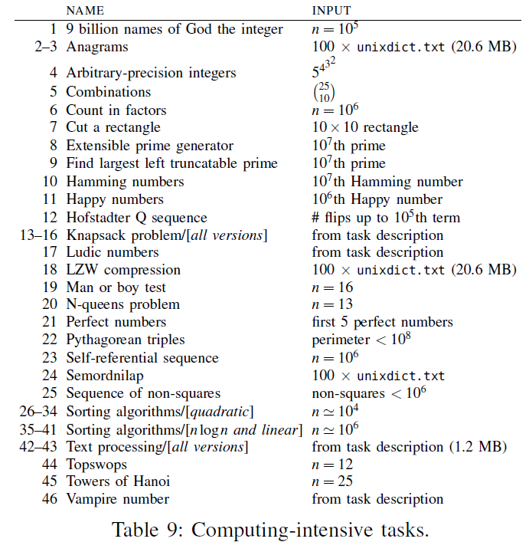
“Scalability tasks”

Slide 62
Running Time
“Scalability tasks”:
Text-processing tasks (Anagrams, Semordnilap).
Combinatorial puzzles (N-Queens problem, Towers of Hanoi).
NP-Complete problems (Knapsack).
Sorting algorithms.
All programs ran on very same inputs.
Minimize effect of I/O.

Slide 63
Running Time - Why it is important?
Well, duh…
However:
In real-time systems it is critical.
Systems with performance needs – large inputs (i.e. web traffic).
On “information”/”everyday“ type applications – maybe less important?
“Most applications do not actually need better performance than Python offers”¹

Slide 64
What might affect running time?
Object oriented features
Constructors, Destructors.
Polymorphism /Dynamic dispatch.

Slide 65
What might affect running time?
Heap management, Garbage collection.
Transitions into machine code.

Slide 66
Any guess ?
Running time – computing intensive tasks
 | Language | Interpreted/byte code | OO features | Functional features
Procedural | C
 | Go
OO | Java | V | V
 | C# | V | V
Functional | Haskell |  |  | V
 | F# | V |  | V
Scripting | Python | V

Slide 67
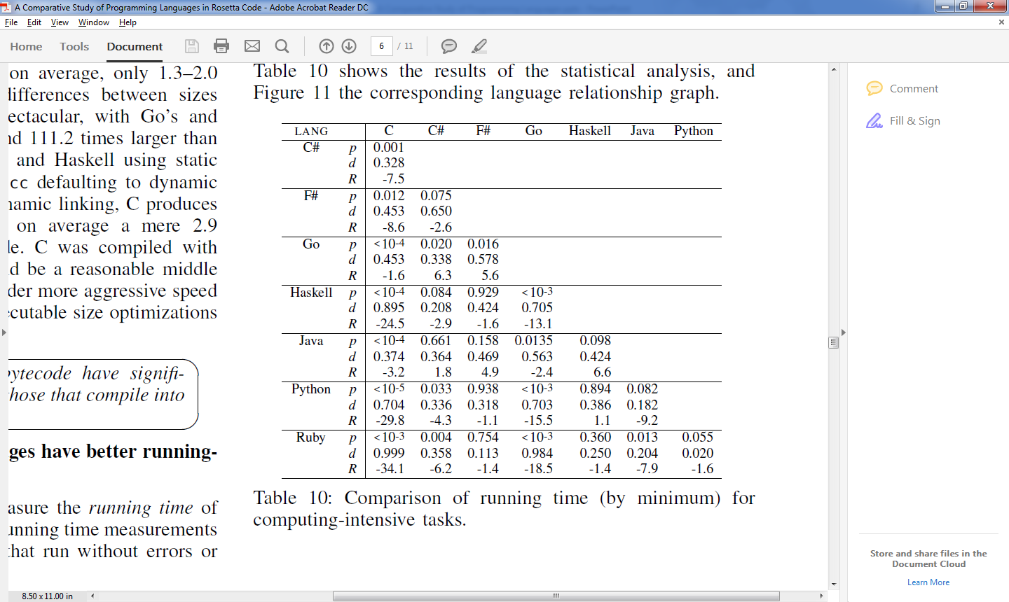
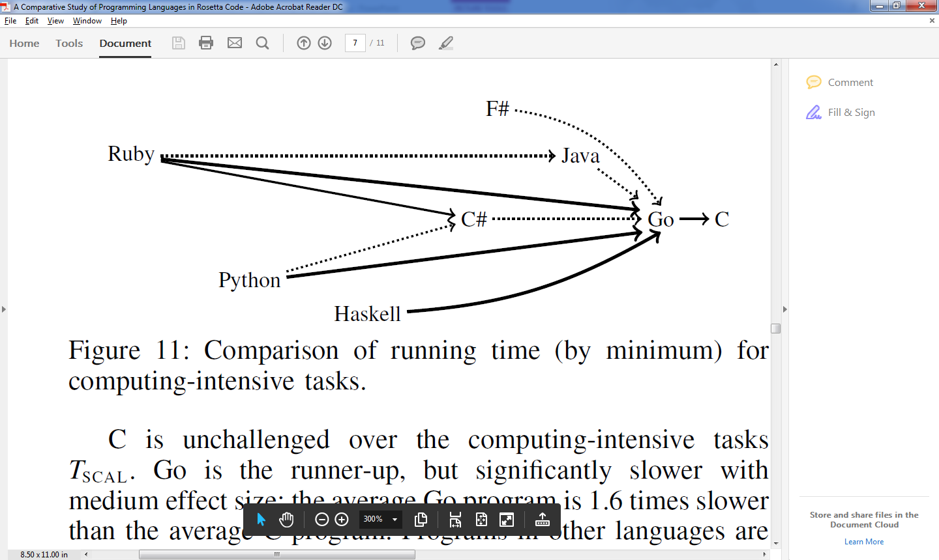
Results – RQ3 (Running Time: Computing-intensive tasks)

Slide 68
Running Time
Procedural languages win. Scripting/Functional languages lose.
Big winner: C, Runner-up: Go (1.6 slower than C).
Ratio: Big – Haskell and Python 15.5-13.1 slower than Go.

Slide 69
Running Time – Performance tasks
Tasks that can be measured for performance, but don’t scale naturally to large instances.
Checksum algorithms (Credit Card Validation).
String manipulations (reversing words inside a string).
System-library access (Securing a temp file).

Slide 70
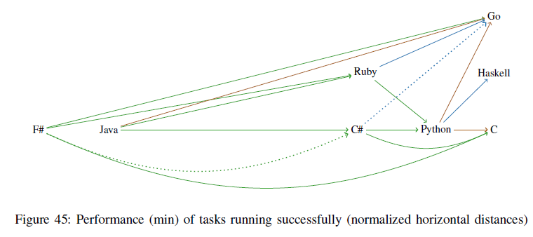
Results – RQ3 (Running Time: “Normal” performance tasks)

Slide 71
Running Time – Performance tasks
Results are much more varied.
The ratios are smaller: C# on Java: 2.5 faster, Python on Java: 6.6 faster.
Winners: Procedural and Haskell, but all are reasonable.
“Everyday” vs. “computing intensive”.

Slide 72
Memory Usage
RQ4 : Which programming languages use memory more efficiently ?
Maximum RAM size consumed by the program.
“Scalability tasks”.
Includes memory of “runtime environment” (i.e. JVM)

Slide 73
Mem. Usage - Why it is important?
Value of RAM – in question.
Still:
Application competing with others (mobile).
“Performance” systems – must not exceed RAM (swap to disk).

Slide 74
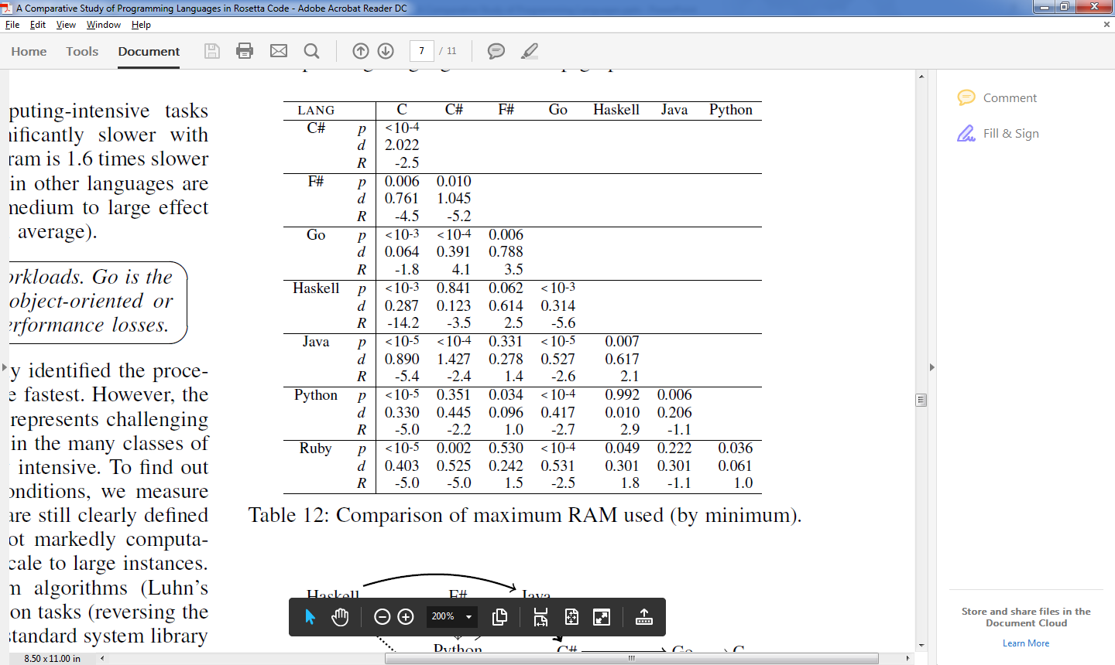
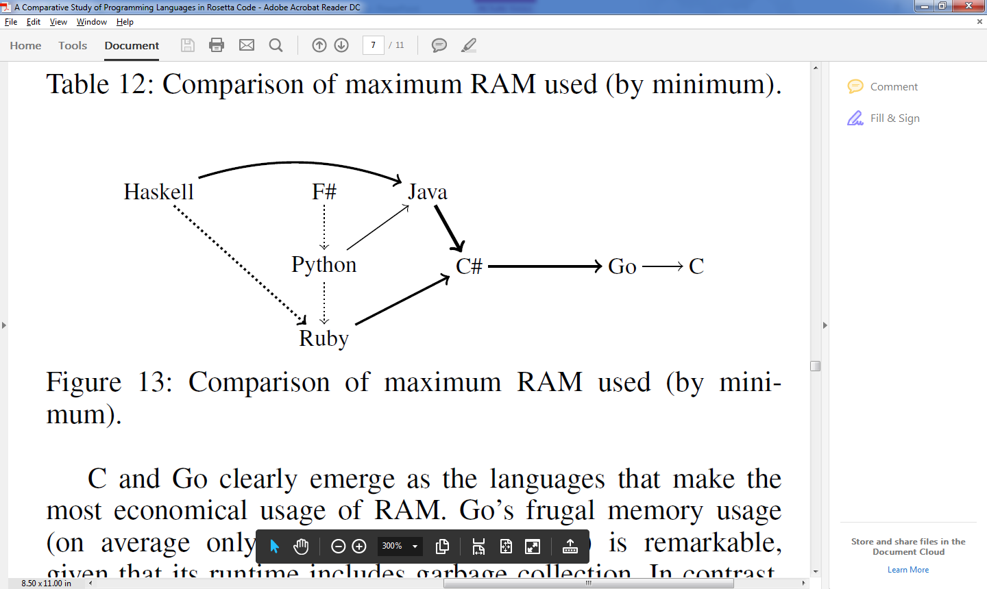
Results – RQ4 (Max Memory usage)

Slide 75
Mem. Usage
Page faults on functional languages.

Slide 76
Safety / failure-proneness
RQ5 : Which programming languages are less failure-prone?
Why is it important ?
Provide reliable software.
“If it compiles, it runs”.

Slide 77
Safety
What might affect safety?
Weakly/Strongly typed
Compiled or interpreted

Slide 78
Strong/weak type systems ¹
Type safety:
All variables must a declared type.
Explicit conversions.
Implicit conversions.
Pointer arithmetic.
Past research²

Slide 79
Any guess ?
Safety/Failure-proneness
 | Language | Interpreted | Weak typing
Procedural | C |  | V
 | Go
OO | Java
 | C#
Functional | Haskell
 | F#
Scripting | Python | V
 | Ruby | V

Slide 80
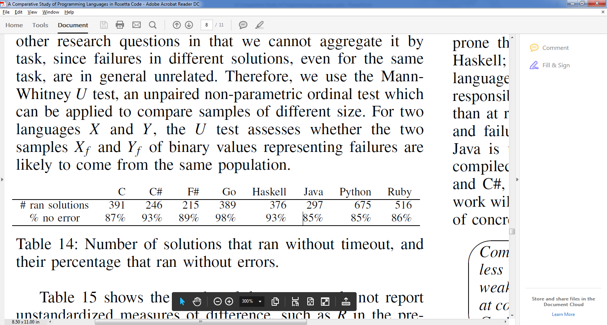
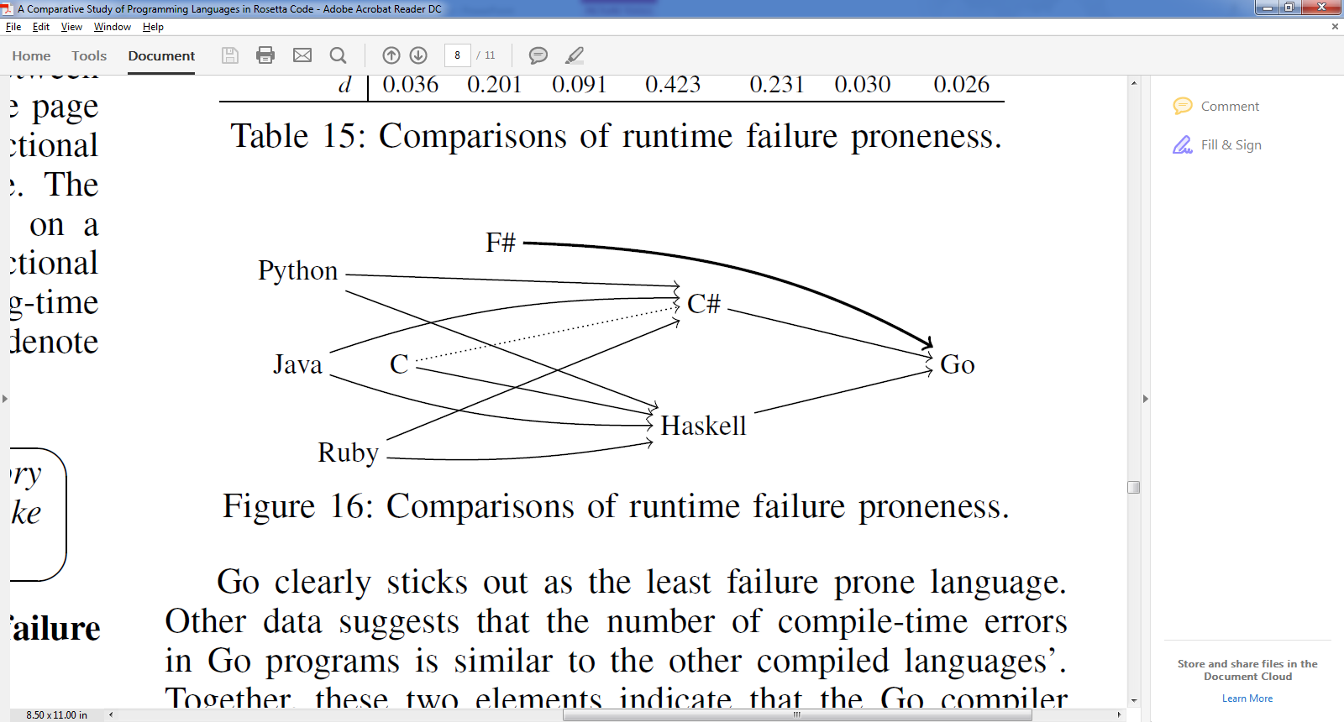
Results – RQ5 (Safety)

Slide 81
Time allocation
Overview
Research Method
Programming paradigms overview
Comparison & Results
Validity & Discussion

Slide 82
Results conclusions
 | Language | Conciseness | Size of executable | Running time | Memory usage | Safety
Procedural | C |  | V | V | V
 | Go |  |  | V | V | V
OO | Java |  | V | V | V
 | C# |  | V |  | V | V
Functional | Haskell | V |  |  |  | V
 | F# | V | V | V |  | V
Scripting | Python | V | V
 | Ruby | V | V

Slide 83
Results conclusions
Functional and scripting are shorter
Language that compile to byte code have smaller exec.
C (Go) are the fastest on intensive load
“Everyday” workload all are equally competitive
Procedural languages consume less memory.
Compiled, strongly-typed languages have less runtime errors.

Slide 84
Results conclusions
No big winner == trade-offs.
Programming paradigms behave similarly.

Slide 85
Threats to validity
Internal validity
External validity
Bias for Algorithmic and small problems
Contributors
Selection of languages

Slide 86
Further discussion
The people that make the code. ¹
Other aspects: Design, algorithms, work procedures.
Industry

Slide 87
Bibliography
https://en.wikipedia.org/wiki/Programming_paradigm
Hatton, Programming Languages and Safety-Related Systems , 1995
E.s. Raymond, the art of unix programming, 2003
Ray et al, "A Large scale study of programming languages and code quality in GitHub", 2014
L. Prechelt, "An empirical comparison of seven programming languages", 2000

